Slide 1
Incident Response Playbook & Forensics Lab
By Group 2
Information Security

Slide 2
RoadMap
Incident Overview
Evidence Collection
Forensic Analysis
Documenting Finds
Incident Response Playbook
NIST IR Framework Evaluation
Lessons Learned & Conclusion

Slide 3
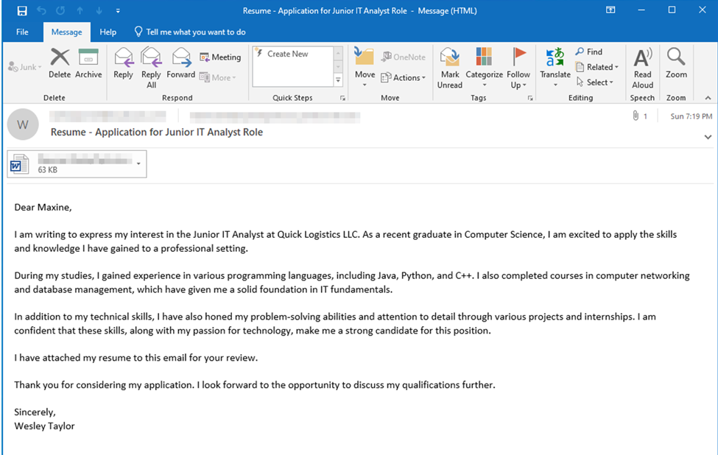
Incident Overview I

Slide 4
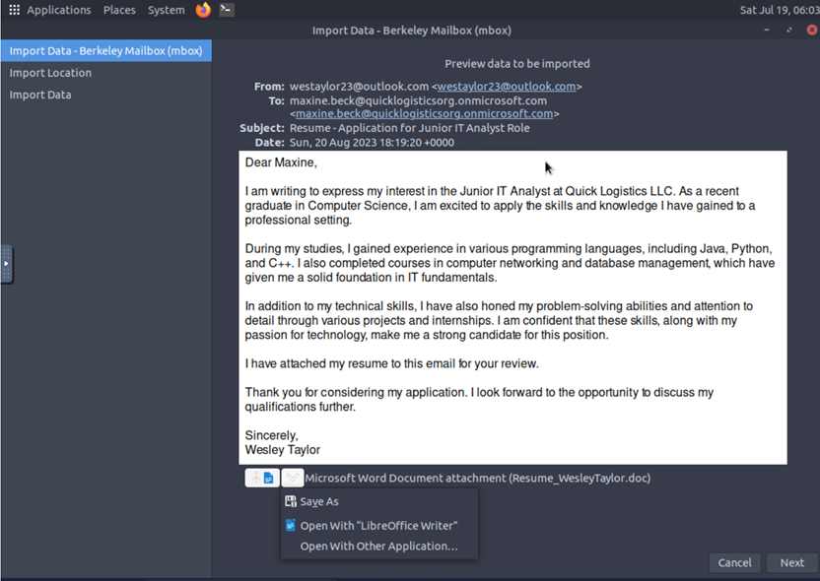
Incident Overview I
The incident simulated a phishing attack aimed at an HR employee of Quick Logistics LLC.
The phishing email disguised as a job application.
It contained a malicious resume attachment (Word document).
When the attachment was opened, it triggered a chain of malicious actions.
This sequence ultimately compromised the HR employee’s computer.

Slide 5
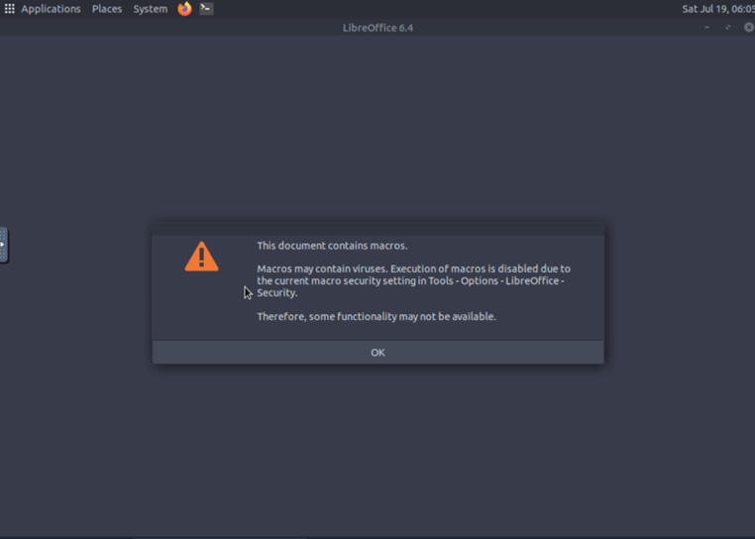
Incident Overview II

Slide 6
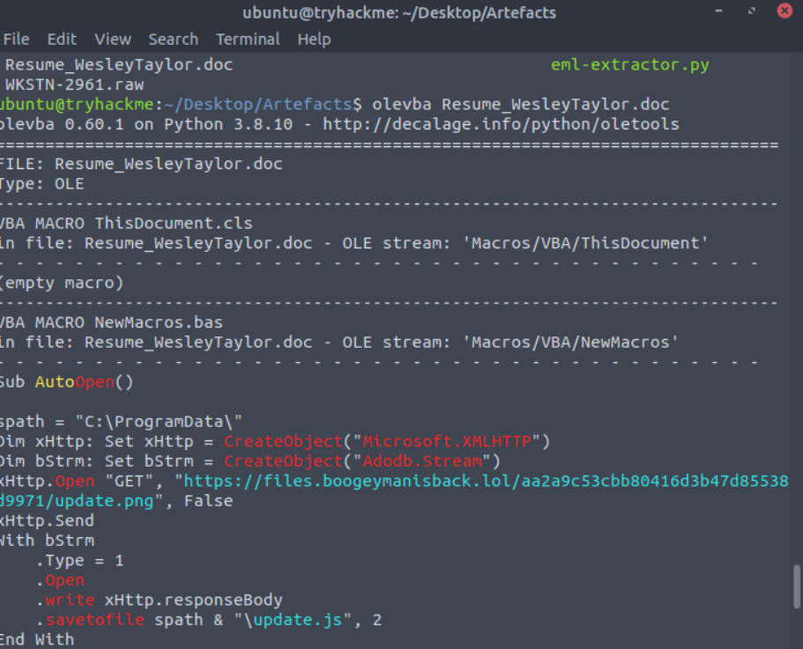
Evidence Collection I
Part 1: Email and Attachment Analysis
Here are the bullet points based on your paragraph:
The suspicious Word document (resume_WesleyTaylor.doc) was downloaded to our analysis environment.
To inspect for hidden macros, we ran the command: olevba resume_WesleyTaylor.doc in the Ubuntu terminal.
Olevba extracted and analyzed any embedded VBA macros.
.

Slide 7
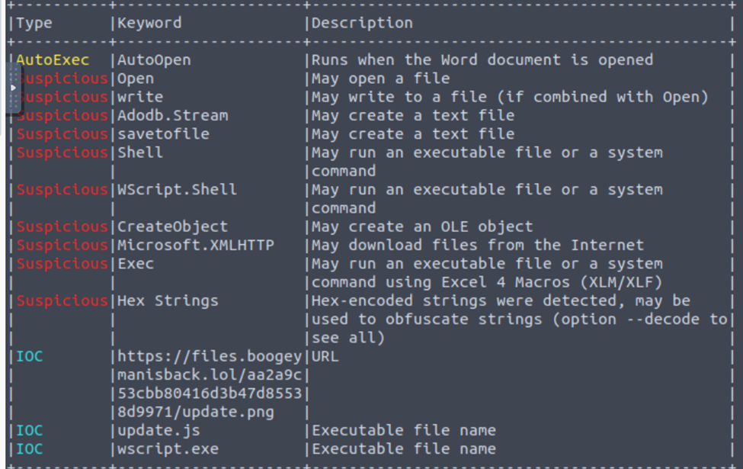
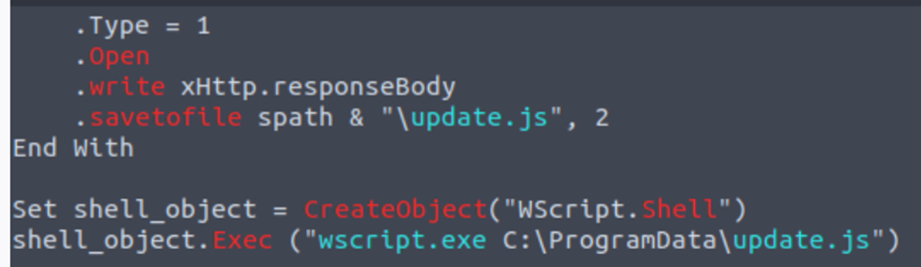
Evidence Collection II
he tool printed out the actual macro code and highlighted suspicious keywords, such as:
AutoOpen – enables code to run automatically when the document is opened
CreateObject – allows creation of COM objects
Shell – used to execute system commands
The macro was designed to download and execute a secondary payload, update.js.
Execution was done using wscript.exe, a trusted Windows utility that is often abused by attackers.

Slide 8
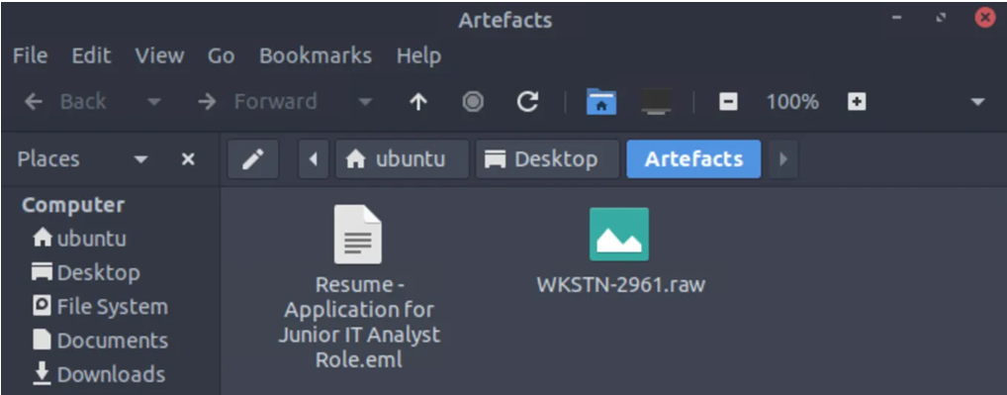

Slide 9

Artefacts Analysis I
To identify Indicators of Compromise (IOCs), we used the Volatility plugin windows.pstree.
This plugin shows how programs were opened and how they are related at the time the memory was captured.
The output revealed the following process chain:
OUTLOOK.EXE (PID 1440) ↓
WINWORD.EXE (PID 1124, opened by OUTLOOK.EXE) – Started at 14:12:31 ↓
wscript.exe (PID 4260, opened by WINWORD.EXE) – Started at 14:12:47
This chain is suspicious because Microsoft Word typically should not launch wscript.exe, a scripting engine.
The fact that wscript.exe was launched just 16 seconds after Word opened is a strong IOC, indicating potential macro-based malicious activity.

Slide 10
Incident Response and Forensic Lab
THANK YOU

Slide 11
Artefacts Analysis II
his process chain aligns with earlier findings from running olevba, which showed that:
The malicious resume contained macro code
The macro downloaded and ran a script called update.js using wscript.exe.

Slide 12
Incident Summary + Next Steps
To summarize:
The attack started with a phishing email and used a malicious Word doc to deploy a JavaScript downloader.
Execution was achieved using trusted Windows tools to evade detection.
Persistence was established via scheduled tasks and PowerShell scripts.
We confirmed attacker activity through email headers, macro extraction, memory forensics, and system logs.
Incident Response Playbook

Slide 13
Incident Response Playbook
1. Preparation - Conduct security awareness training (esp. HR staff) on phishing and macro-enabled docs
- Disable Office macros by default unless vetted
- Implement email security filters (e.g., SPF, DKIM, DMARC…)
- Ensure endpoint logging and EDR tools are active on all client machines
4. Eradication - Delete malicious files: Resume_WesleyTaylor.doc, update.js, Remove scheduled tasks and startup entries linked to the payload
- Clean up registry modifications, run AV/malware scans
- Patch Office and OS vulnerabilities exploited in the attack
2. Detection & Analysis - Monitor for suspicious emails (subject, sender mismatches, strange attachments)
- Alert triggers for Office spawning scripting engines (e.g., WINWORD.exe → wscript.exe)
- Use SIEM or EDR tools to flag rare PowerShell and JS executions
- Review memory dumps, system logs, email headers, scheduled tasks
5. Recovery - Restore clean backups if OS integrity is compromised
- Re-enable NIC and monitor system/network traffic
- Closely monitor logs for signs of reinfection or beaconing
- Resume operations only after validation of system integrity
3. Containment - Isolate infected system from the network immediately (disable NIC, remove from domain)
- Capture volatile memory and disk image
- Preserve malicious email and attachment for analysis
- Disable affected AD accounts or reset credentials if needed
6. Post-Incident - Conduct internal debrief and revise playbook
- Update training modules based on attacker TTPs
- Feed IOCs (IP, domain, hash of Resume.doc, update.js) into threat intel platforms
- Conduct tabletop exercises using this scenario to test response readiness

Slide 14
NIST IR Framework Evaluation
Preparation
Strengths:
Implement security awareness training and possess email authentication controls like SPF and DKIM
Endpoint detection and response software is properly set up on every client machine.
Gaps:
Lack an asset inventory with criticality classifications for endpoints, servers, or networks
No baseline activity profiles exist for normal email traffic patterns or typical user activity.
Detection & Analysis
Strengths:
Employ multi-channel detection techniques such as email header analysis and endpoint process monitoring
Establish the clear alert criteria for suspicious behavior such as Office applications launching scripting engines.
Gaps:
Lack mechanisms to identify attack precursors before compromise occurs
Detection plans lack behavior-based analytics to detect anomalies in activity patterns.
Containment, Eradication, and Recovery
Strengths:
Containment: Compartmentalize affected systems and preserve forensic data through best practices
Eradication: Malware removal procedures comprehensively address file deletion, registry deletion, and patching of vulnerabilities.
Gaps:
The response plan should have criticality-based levels for containment prioritization of high-value assets
Formal recovery time targets should be established for different system types.
Post-Incident Activity
Strengths:
Collect indicators of compromise and revises response procedures through lessons learned.
Gaps:
A formal metrics program should track mean time to detect and to respond for continued improvement
Legal, HR, and communications stakeholders should be represented in after-action reviews to get a full measure.

Slide 15
Lesson Learned
Phishing Awareness
Even trained employees can fall for well-crafted phishing lures. More interactive, role-based phishing simulations are necessary—especially for HR.
Macro Security
Macros remain a highly exploitable vector. Office group policies should disable macros from untrusted sources.
Living-off-the-Land (LOLBins)
Tools like wscript.exe and powershell.exe are often abused. These should be monitored, if not restricted, in corporate environments.
Logging & Forensics
Memory capture and logs were vital to reconstruct the attack chain. Maintaining continuous logging and snapshot capability is critical.
Persistence Mechanisms
Attackers use Scheduled Tasks and scripts for stealthy persistence. Defensive monitoring should include scheduled task creation and startup modifications.
Incident Response Readiness
A documented playbook with clearly assigned roles improves response time and coordination during real incidents.
IOC Sharing
Hashes, domains, and behaviors identified should be shared internally and with trusted external partners.

